Slide 1
(West Manor Elementary)

Slide 2
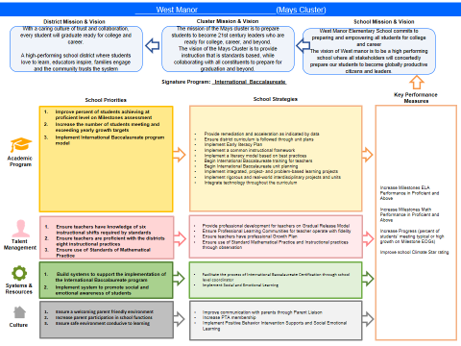
West Manor FY18 Strategic Plan

Slide 3
FY18 Funding Rationale
FY’ 18 Funded School Priority | Rationale
Improve percent of students achieving at proficient level on Milestones assessment | Prepare our students for the next level of education
Implement International Baccalaureate program model | Provide rigor and ensure our students think globally
Ensure teachers are proficient with the districts eight instructional practices | Teachers will provide solid instruction daily surpassing district expectations
Ensure a welcoming parent friendly environment | Increase parent involvement to strengthen the partnership between school and home

Slide 4
Description of Strategy Categories
Priorities – FY18 funding priorities from the school’s 3-5 year strategic plan.
Strategies – Lays out specific objectives for schools improvement
Request – “The Ask”. What needs to be funded in order to support the strategy?
Funding Source – What source of funds will finance the request (i.e. general, cluster, signature, Title I)

Slide 5
Focus Area Descriptors
Strategic Plan Categories | District Descriptions of Categories
Academic Program | Our students will be well-rounded individuals who possess the necessary academic skills and knowledge and are excited about learning.
Talent Management | We will retain an energized and inspired team of employees who are capable of advancing ever-increasing levels of achievement for students of all backgrounds.
Systems & Resources | We will improve efficiency (productivity, cost, etc.) while also making decisions (including resource allocations) that are grounded in a strategic academic direction and data.
Culture | We will build trust with the community, and we will have engaged stakeholders (employees, students, parents, community members, partners, etc.) who are invested in the mission and vision and who support the creation of student-centered learning communities.

Slide 6
FY18 Strategic Plan Break-out
Priorities | Focus Area | Strategies | Requests | Funding Sources | Amount
Improve percent of students achieving at proficient level on Milestones assessment | Academics | Provide remediation and acceleration as indicated by data Ensure district curriculum is followed through unit plans Implement Early literacy Plan Implement a common instructional framework Implement a literacy model based on best practices | Purchase staff to allow for class size below district average and meet APS Standards of Service for Elementary Schools | General funds | 2,953,996
Implement International Baccalaureate program model | Academics Talent Management Systems and Resources | Implement integrated, project- and problem-based learning projects Implement rigorous and real-world interdisciplinary projects and units Integrate technology throughout the curriculum | Hire IB Coordinator Begin International Baccalaureate training for teachers Begin International Baccalaureate unit planning | Signature Funds | 246,534.10
Increase the number of students meeting and exceeding yearly growth targets | Academic Talent Management Systems and Resources | Integrate technology throughout the school Provide resources for daily instruction Provide Extended day tutorials | Provide Instructional Coach Provide Student Support Team Coach Provide tutors for extended day program | Title One General Funds | 167,455
Ensure a welcoming parent friendly environment Increase parent participation in school functions | Culture | Improve communication with parents through Parent Liaison Increase PTA membership Implement Positive Behavior Intervention Supports and Social Emotional Learning | Provide a Parent Liaison Provide Social Emotional Learning Coordinator, Social Worker, Nurse | Title One | 30,000

Slide 7
Discussion of Budget Summary

